Slide 1
Predicting the Quality of Semen Samples Based on Socio Demographic & LifeStyle Factors Charu Girdhar ANLY-510 - 90-O- 2018 Spring

Slide 2
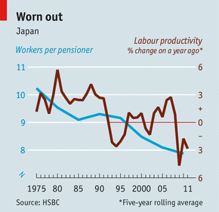
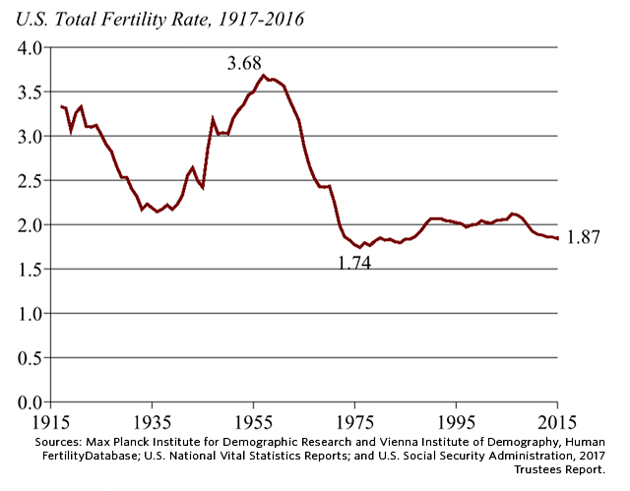
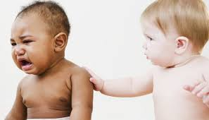
THE DECLINE IN FERTILITY RATE = LOWSEMEN QUALITY
Aging population
Productivity & Living standards
labor force and economic potential
the health of next generation

Slide 3
Facts from research papers & scientific articles
Of all infertility cases, approximately 40–50% is due to “male factor” infertility ~ Source: Men's Health – Male Factor Infertility. University of Utah Health Sciences Center. 04 January, 2003
The rates of infertility in less industrialized nations are markedly higher and infectious diseases are responsible for a greater proportion of infertility. ~ Source: Trends of male factor infertility, an important cause of infertility, Naina Kumar, Oct-Dec, 2015
estimates suggest that nearly 72.4 million couples globally experience fertility problems ~ Source: Trends of male factor infertility, an important cause of infertility, Naina Kumar, Oct-Dec, 2015
There has been a genuine decline in semen quality over the past 50 years. As male fertility is to some extent correlated with sperm count the results may reflect an overall reduction in male fertility ~ source: Evidence for decreasing quality of semen during past 50 years. Carlsen E, Giwercman A, Keiding N, Skakkebaek NE BMJ. September, 1992
Whilst formulating new World Health Organization (WHO) guidelines for the diagnosis of male infertility a striking observation was the paucity of high quality data on which to base recommendations Source: the importance and strategy for placing male reproductive health centre stage in the political and research agenda. Christopher L R Barratt Christopher J De Jonge Richard M Sharpe. (2018Human Reproduction, ‘Man Up).
Approximately 90% of Americans have BPA (Bisphenol A) present in their blood. BPA is a prevalent chemical that is known to reduce sperm count, motility, and viability, it is a significant environmental threat to male fertility. ~ Source: Environment and Male Fertility, Agarwal, Ashok, Jan 27, 2014
sperm counts among men in the west have more than halved in the past 40 years and are currently falling by an average of 1.4% a year. ~ Source: The infertility crisis is beyond doubt. Now scientists must find the cause, The observer, July, 2017

Slide 4
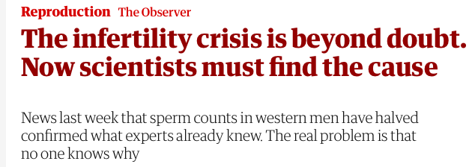
Data Description
Summary of Variables:
100 obs. of 10 variables
Research Objective: The primary objective of this paper is to determine whether socio-demographic, environmental and life style factors affect semen quality.
Attributes | Type
Season | Categorical
Age | Continuous
Childhood disease | Categorical
Serious accidents | Categorical
Surgical interventions | Categorical
High Fever | Categorical
Alcohol consumption | Categorical
Smoking habit | Categorical
Sitting hours Diagnosis | Continuous Categorical
Abstract: 100 volunteers provide a semen sample analyzed according to the WHO 2010 criteria. Sperm concentration are related to socio-demographic data, environmental factors, health status, and life habits
Number of Data Records: 100
Source: UCI EDU website
Number of Volunteers: 100
No repeated observations from same volunteer.

Slide 5
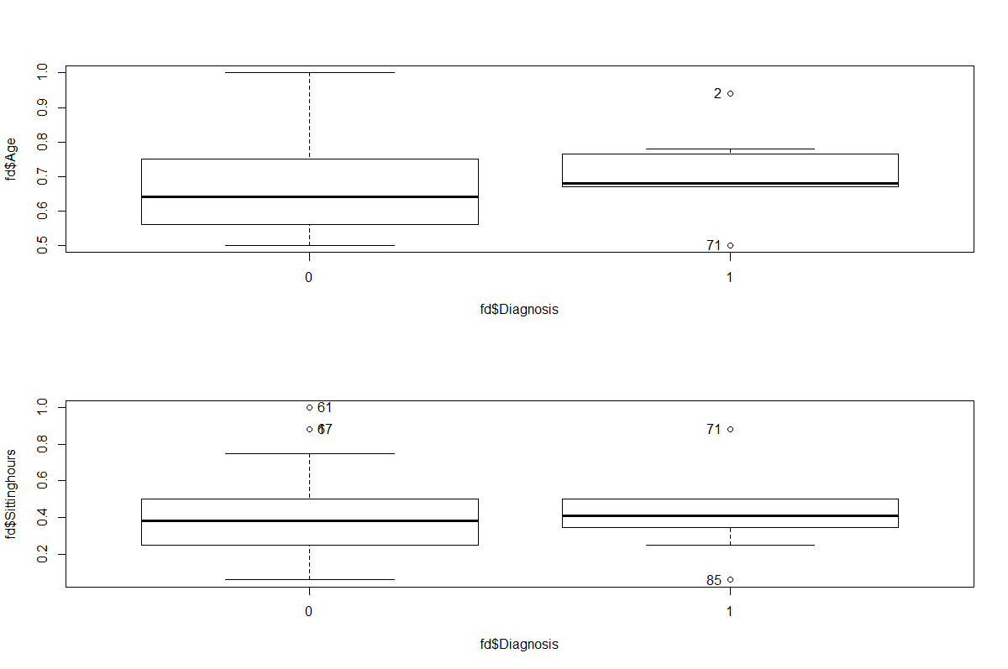
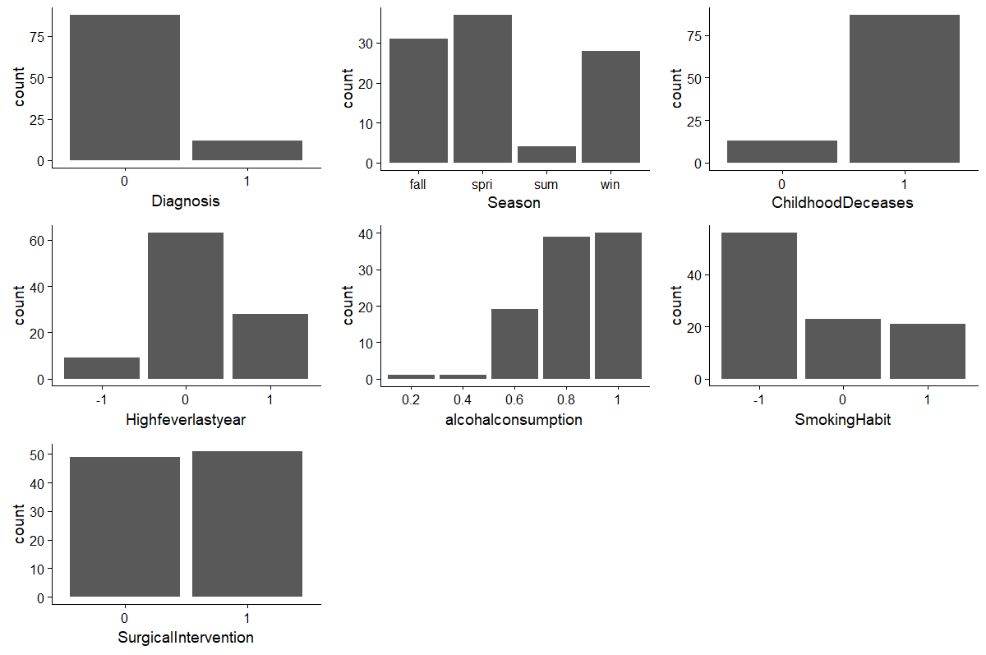
Exploratory Data Analysis
Analyzing the distribution and spread of the data (bar plots for categorical, boxplots for continuous data ) before fitting the model.
Categorical Data
Continuous Data

Slide 6
Chi-Square Test of Independence
Between Diagnosis and categorical predictors Between Predictors themselves (only significant once)
Var1 | Var2 | P Value | Independence Hypothesis
Diagnosis | Season | 0.2446 | Fail to Reject
Diagnosis | Childhood Decease | 1 | Fail to Reject
Diagnosis | Accident | 0.2698 | Fail to Reject
Diagnosis | Surgical Intervention | 0.815 | Fail to Reject
Diagnosis | High fever last year | 0.4618 | Fail to Reject
Diagnosis | Alcohol Consumption | 0.4025 | Fail to Reject
Diagnosis | Smoking Habit | 0.898 | Fail to Reject
Var1 | Var2 | P Value | Independence
Alcohol consumption | Smoking Habit | 0.03295 | Rejected Null
Surgical Intervention | High fever last year | 0.01926 | Rejected Null
Season | High fever last year | 0.02839 | Rejected Null
Season | Accident | 0.04491 | Rejected Null
We cannot reject the hypothesis that they are independent, Because we may not have enough observations to reject the null.
That doesn’t mean they might not be associated given more observations(evidence).
These are the variables which showed some association
among each other.
Again keep in mind the rest of variables might also be
Associated , we just don’t have enough evidence.

Slide 7
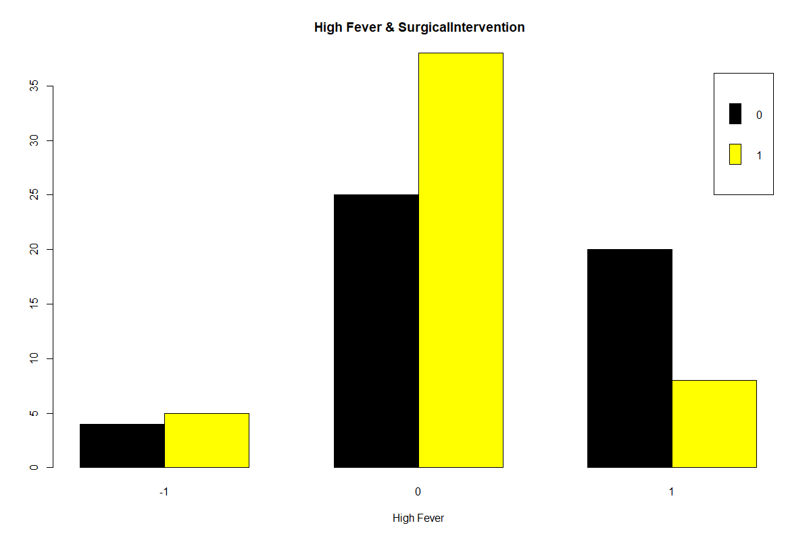
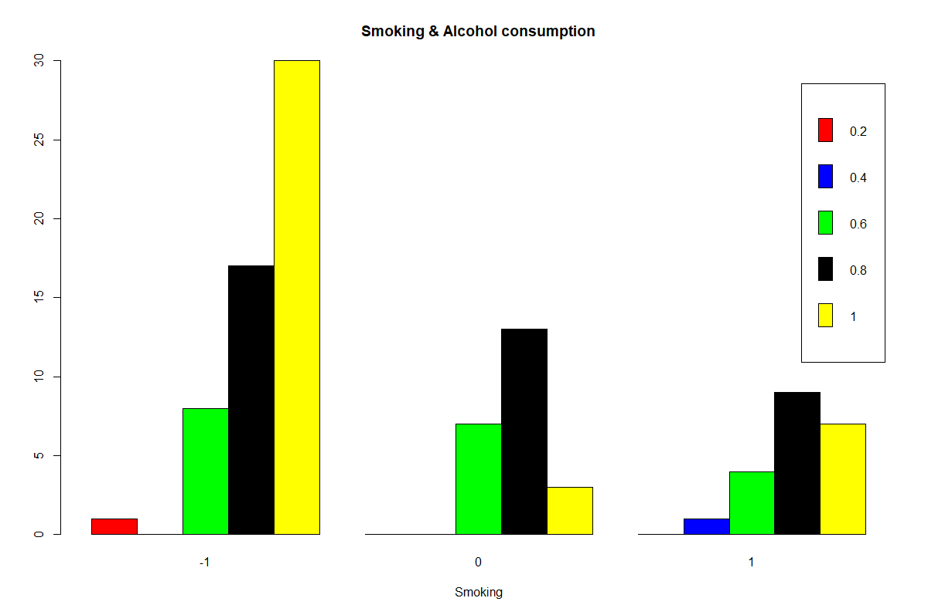
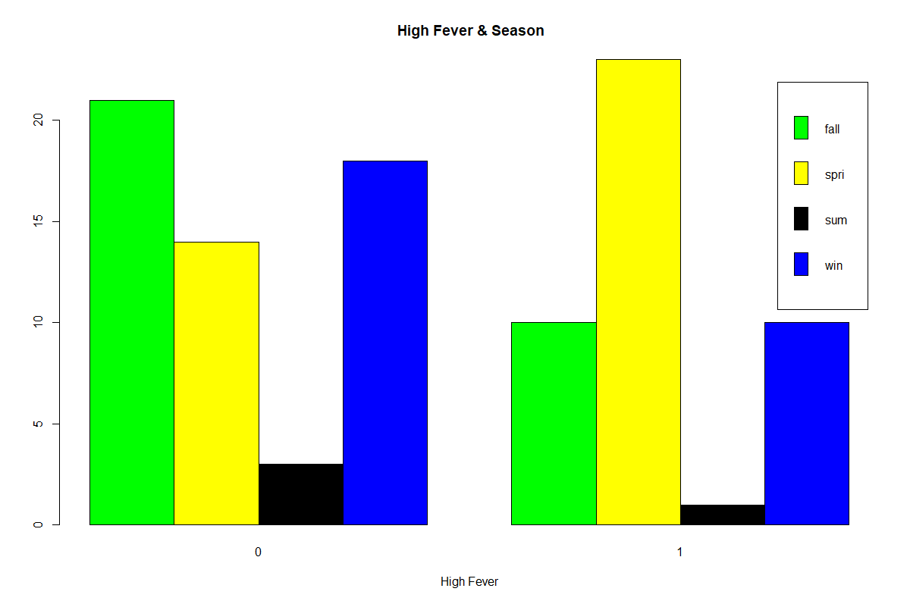

Graphical comparisons between associated variables using bar plots

Slide 8
Logistic Regression models
Fuller model:
model <- glm(fd$Diagnosis ~ Age * Season * ChildhoodDeceases*Accident*SurgicalIntervention*Highfeverlastyear*alcohalconsumption*SmokingHabit*SmokingHabit, family = binomial(logit), data = fd )
Residual deviance: 2018.445 on 6 degrees of freedom
Reduced model 1:
model1 <- glm(fd$Diagnosis ~ . + SmokingHabit:alcohalconsumption , family = binomial(logit), data = fd )
Reduced model 2:
model2 <- glm(fd$Diagnosis ~ . + SmokingHabit:alcohalconsumption - Season - SurgicalIntervention , family = binomial(logit), data = fd )

Slide 9
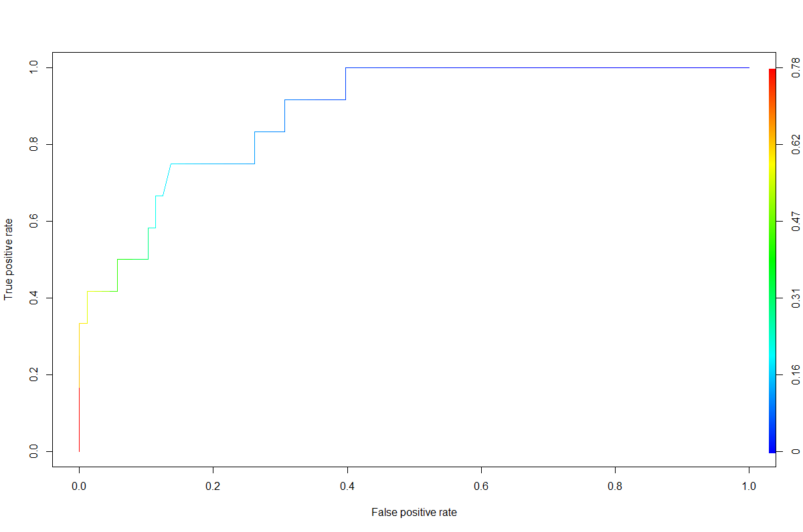
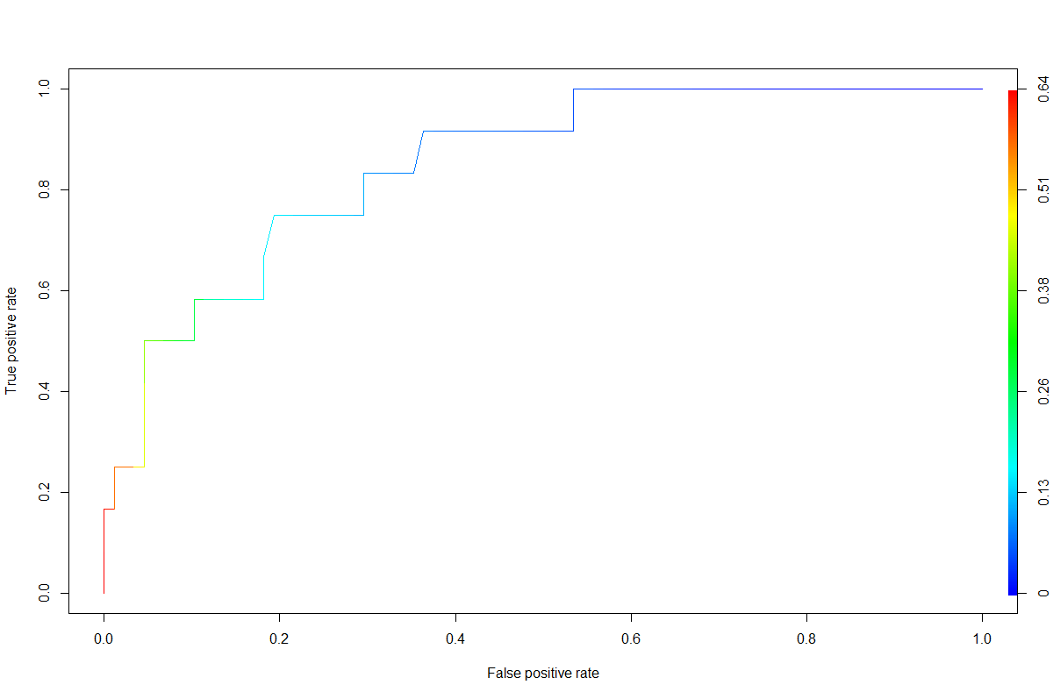


Model comparisons
Model 1
1) Deviance Residuals:
Min 1Q Median 3Q Max
-1.2848 -0.4697 -0.1920 -0.0565 2.4692
2) Residual deviance : 49.295 on 79 degrees of freedom
3) AIC : 91.3
4) Pseudo R Square: McFadden r2ML r2CU
0.3282686 0.2140797 0.4117371
5) ROC Plot
MODEL 2
1) Deviance Residuals:
Min 1Q Median 3Q Max
-1.29650 -0.48667 -0.26204 -0.09041 2.45378
2) Residual deviance : 53.936 on 83 degrees of freedom
3) AIC : 87.9
4) Pseudo R Square: McFadden r2ML r2CU
0.2650324 0.1767489 0.3399391
5)ROC PLOT
We decided to go with Reduced model1

Slide 10
Reduced Model 1 vs Reduced Model 2
 | Estimate | Std. Error | z value | Pr(>|z|)
(Intercept) | -25.2927 | 6522.64 | -0.00388 | 0.99690606
Season-0.33 | 1.508674 | 1.482928 | 1.017361 | 0.30898151
Season0.33 | 2.086474 | 2.138667 | 0.975596 | 0.32926477
Season1 | 2.49916 | 1.421861 | 1.757668 | 0.078804
Age | 5.222465 | 4.303379 | 1.213573 | 0.22491086
Childhooddiseases1 | 0.992572 | 1.133854 | 0.875396 | 0.3813583
AccidentalTrauma1 | -1.90539 | 1.004031 | -1.89774 | 0.05773046
Surgicalintervention1 | 0.02365 | 0.873315 | 0.02708 | 0.97839566
Highfeverlastyear0 | -1.1721 | 1.228021 | -0.95447 | 0.33984799
Highfeverlastyear1 | -2.25372 | 1.468971 | -1.53422 | 0.12497557
alcoholconsumption0.4 | -2.34319 | 9224.405 | -0.00025 | 0.99979732
alcoholconsumption0.6 | 18.56064 | 6522.639 | 0.002846 | 0.99772957
alcoholconsumption0.8 | 17.55817 | 6522.639 | 0.002692 | 0.99785219
alcoholconsumption1 | 14.3959 | 6522.639 | 0.002207 | 0.99823902
Smokinghabit0 | -11.258 | 3524.605 | -0.00319 | 0.99745147
Smokinghabit1 | 3.244776 | 1.878397 | 1.727418 | 0.08409261
Sittinghours 1 | 5.518645 | 3.018928 | 1.828015 | 0.06754733
alcoholconsumption0.6:Smokinghabit0 | 10.6229 | 3524.605 | 0.003014 | 0.99759524
alcoholconsumption0.8:Smokinghabit0 | 9.407298 | 3524.605 | 0.002669 | 0.99787042
alcoholconsumption0.6:Smokinghabit1 | -21.6713 | 2847.221 | -0.00761 | 0.99392705
alcoholconsumption0.8:Smokinghabit1 | -3.01927 | 2.342402 | -1.28896 | 0.19741121
 | Estimate | Std. Error | z value | Pr(>|z|)
(Intercept) | -22.5428 | 6522.64 | -0.00346 | 0.997242443
Age | 4.910849 | 3.589015 | 1.3683 | 0.171218265
Childhooddiseases1 | 0.660413 | 1.052424 | 0.627516 | 0.530320886
AccidentalTrauma1 | -1.89758 | 0.956841 | -1.98317 | 0.047347999
Highfeverlastyear0 | -0.62077 | 1.142059 | -0.54356 | 0.586747216
Highfeverlastyear1 | -2.29024 | 1.385268 | -1.65329 | 0.098272827
alcoholconsumption0.4 | -3.02965 | 9224.404 | -0.00033 | 0.999737944
alcoholconsumption0.6 | 17.89927 | 6522.639 | 0.002744 | 0.997810467
alcoholconsumption0.8 | 16.93819 | 6522.639 | 0.002597 | 0.997928032
alcoholconsumption1 | 14.04615 | 6522.639 | 0.002153 | 0.9982818
Smokinghabit0 | -13.2294 | 3429.723 | -0.00386 | 0.996922345
Smokinghabit1 | 3.043622 | 1.777455 | 1.712348 | 0.086832527
Sittinghours | 4.874074 | 2.973309 | 1.639276 | 0.101155785
alcoholconsumption0.6:Smokinghabit0 | 12.41588 | 3429.723 | 0.00362 | 0.997111599
alcoholconsumption0.8:Smokinghabit0 | 11.58766 | 3429.724 | 0.003379 | 0.997304273
alcoholconsumption0.6:Smokinghabit1 | -21.1252 | 3034.205 | -0.00696 | 0.994444901
alcoholconsumption0.8:Smokinghabit1 | -3.10904 | 2.1802 | -1.42603 | 0.153858897

Slide 11
discussion
Daily smoking habit, fall season, and long sitting hours increase the likelihood of semen alteration by a factor of 2.56, 2.49, and 1.21.
Negative significance of no accidental trauma suggest decrease in the likelihood of semen alteration by a factor of 1.48.
The area under the curve is 0.88..
McFadden’s R squared for both model fall within the range of 0.2-0.4 which indicates a strong fit.

Slide 12

Conclusion
Our study suggests that daily smoking habit, fall season , and long sitting hours increase the likelihood of semen alteration whereas chances of having a normal semen quality for male are more when they have no accidental trauma.
Lack of strong significance can be due to small sample size.

